Slide 1
Euromines Magnesite Producers Assembly
Brussels, Sept 7 ’17
Recent Chinese Mineral Policies
Focus on Magnesite
Vasili Nicoletopoulos
Natural Resources PC

Slide 2
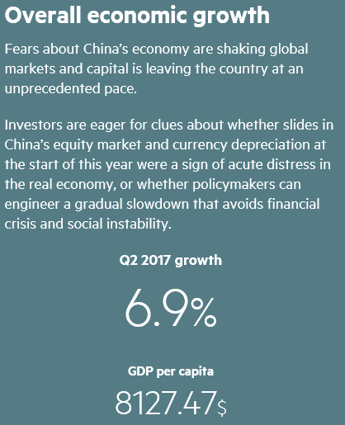
Background: China’s economy today, FT 9 ‘17

Slide 3
6 targets of modern Chinese mineral policy
1. Protect the environment focusing on
air pollution
GHG emissions, incl. plan for national ETS
H&S
2. Save energy & increase resource efficiency
3. Combat tax evasion: VAT, smuggling, other
4. Reduce overcapacities, an issue brought about by the EU, the US etc
5. Comply with WTO rules as measures address production
6…and, indirectly, End era of cheap Chinese minerals

Slide 4
Means employed in 2017
Rigid & repeated inspections, so far up to twice per region
Forbidding mining, banning use of explosives
Temporary [and permanent?] shutting down of mines and of burning plants, especially the small, non-complying ones
Switching from ‘reflection’ to ‘shaft’ kilns for ccm > 18 m3 effective volume [ev]; and from ‘standing’ to ‘rotary’ kilns for dbm >30 m3 ev; eliminating efm furnaces <1400 KVA
Installing filters in ore processing & burning operations
In some case, substituting coal for natural gas
National environmental tax ‘to end era of cheap Chinese minerals’, IM, June 30 ’17. This substitutes the current local fee
Tax evasion clampdown leads to wave of arrests, IM, Aug 14 ‘17

Slide 5
Market results
Pressure on producers to use all raw mag, eliminating selective mining
Shortages
Buyers’ uncertainty -- and even panic
Price increases
Reduction of capacity…
…but some operations come back on line, plus…
…New, modern, plants are inaugurated
Impact on downstream: refractories, boards

Slide 6
Industries affected: Energy…
Coal: small mines shut, price up, but China ramps up coal exports, financing construction of coal power plants in foreign nations
Gas: China's gas use may rise 10% in 2017, Aug 20 ’17; China gas distributors rise as price cut in a bid to increase demand for cleaner fuels, expected to boost demand, Aug 31 ‘17
Nuclear: China currently has 27 nuclear power plants under construction, ~1/3 of the world's unfinished nuclear units
Calcined pet coke prices up sharply in Shandong on environmental inspections, Asian Metal, Sept 1 ‘17

Slide 7
…Industries affected: Minerals and metals…
Antimony trioxide market reaches new highs, IM, Aug 30 ‘17
Dwindling supply lifts Chinese calcined bauxite prices, IM, Aug 25 ‘17
Chinese brown fused alumina prices hit new high, IM, Aug 25 ‘17
Chinese bauxite prices increase on raw material shortage, IM, July 23 ’17
Flake graphite prices rise on new round of plant inspections, Roskill, Aug 30 ’17
China Kings reports surging profits as fluorspar prices rally on environmental policy pressure 29 Aug ’17
Yunnan province starting Sept 11 safety inspections on iron, steel and aluminium plants as part of a crackdown on outdated capacity

Slide 8
… Industries affected: Magnesia…
Chinese Q1 magnesia exports hit record high as values plunge, IM, May 5 ‘17
China’s efm output down 84.7% MOM in May 2017, AM, June 20 ‘17
Chinese efm exports drop in June, IM, Aug 8 ‘17
efm shipments mark 1st turning point after months of record-high increases, dbm exports starting also to edge downward, ccm continues to grow, IM, Aug 8 ‘17
Magnesia prices rise as environmental focus back on Liaoning, IM, Aug 15 ‘17
Chinese efm output down 5% MOM in July, AM, Aug 22 ’17
China’s dbm output up 3.3% MOM in July, AM, Aug 22 ’17
China’s ccm exports up 8.9% MOM in June, AM, Aug 23 ’17
European fused magnesia prices grow over 50%, IM, Aug 30 ’17

Slide 9
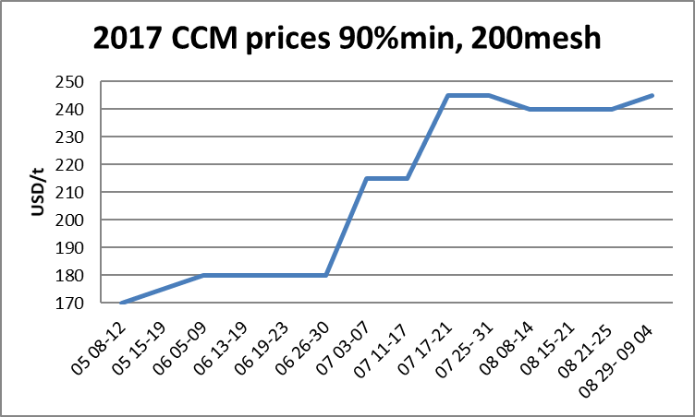
… Industries affected: Magnesia

Slide 10
…Other results
Some capacity comes back on:
Yingkou High Technology to partially switch to produce efm, AM, July 19 ’17
Hartley newly opens 1 high purity magnesia calcining kiln, AM, July 19 ’17
Haicheng Hongda Refractory resumes production of dbm and ccm, Asian Metal, June 2 ’17
Haicheng Magnesite Refractory obtains 10t of explosive, AM, Aug 10 ‘17
Puyang Refractories ups H1 profits but warns of more disruptions, IM, Aug 16 ’17
And new projects start up:
First efm production line in Northwest completed in Jinta, 70k ccm via flotation + 50k efm, AM, Aug 17 ’17
Nationalization and/or forced consolidation a-la-rare earths could follow

Slide 11
Conclusion
The phrase ‘this time it’s different’ has been used many times --- BUT, ‘this time it might really be different’ ☺
China currently trying hard to do two things together
address their tremendous environmental problems
become one of the world leaders
eg. will promote cross-border green bond flows and green finance investment, top central bank official Sept 4
Many years ago in a Euromines Conference in Shanghai, a Chinese official answered me in public, angrily: ‘we will keep polluting until we get to your level of development!’ Now they are getting there fast, but meanwhile they have first hit the environmental bottleneck ☹

Slide 12
Thank you very much
Vasili Nicoletopoulos
Natural Resources PC
Publisher of ‘Weekly Report on China news’

